Slide 1


Introduction to
Robotic Process Automation
RECIPE FINDER BOT
220701111
John Allan J
Mrs. J. Jinu Sophia
Assistant Professor(SG)
Department of Computer Science & Engineering

Slide 2
Abstract
The Recipe Finder Bot is an automated solution designed to assist users in discovering recipes based on available ingredients. The bot leverages web scraping techniques to collect data from multiple online recipe sources, allowing users to input a list of ingredients and receive a curated list of recipes that can be made with those ingredients. It processes user input, performs searches on trusted recipe websites, and returns recipe details such as preparation time, ingredients, instructions, and nutritional information. The bot aims to simplify meal planning, reduce food wastage, and provide users with personalized cooking ideas. By integrating intelligent workflows, the Recipe Finder Bot automates the tedious process of manually searching for recipes, ensuring efficiency and accuracy in recipe suggestions. The system is designed with user-friendly interaction, offering quick responses and a seamless experience. Additionally, it can store and recall user preferences, enhancing future interactions. The project demonstrates the capabilities of UiPath Studio in automating everyday tasks, particularly in the domain of personal meal planning, and showcases the potential of RPA in enhancing daily life through simple yet effective automation solutions.
Department of Computer Science and Engineering
Rajalakshmi Engineering College ‹#›
Notes:
‹#›

Slide 3
Need for the Proposed System
In the modern world, people often struggle with deciding what to cook, especially when they have limited ingredients at hand. The Recipe Finder Bot addresses this challenge by providing tailored recipe suggestions, making cooking a more enjoyable and efficient experience.
Time Efficiency
Searching for recipes manually can be time-consuming. A Recipe Finder Bot instantly provides recipe suggestions based on user inputs, saving significant time.
Ingredient Optimization
Many users are unsure about what to prepare with the ingredients they have. This system helps minimize food wastage by suggesting recipes using available ingredients.
With the increasing reliance on digital tools, a bot that simplifies meal planning aligns with the lifestyle of modern users. It offers convenience by eliminating the need for multiple searching.
Integrating AI and natural language processing enables the bot to interact intuitively with users, offering a seamless and engaging experience.
Department of Computer Science and Engineering
Rajalakshmi Engineering College ‹#›
Notes:
‹#›

Slide 4
Advantages of the Proposed System
Provides instant suggestions based on the user's available ingredients, saving time and effort.
Eliminates the need to search through multiple websites or cookbooks.
Suggests recipes using leftover or surplus ingredients, ensuring optimal utilization of food items.
Encourages sustainability by promoting mindful cooking habits.
Tailors recipes based on user preferences, such as dietary restrictions, allergies, or cuisines.
Offers calorie-conscious or healthy meal options for fitness enthusiasts.
User-friendly interface ensures that even non-tech-savvy individuals can benefit from it.
Helps users maintain specific diets (e.g., keto, vegan, gluten-free) by filtering recipes.
Offers balanced meal suggestions to cater to dietary requirements.
Department of Computer Science and Engineering
Rajalakshmi Engineering College ‹#›
Notes:
‹#›

Slide 5
Literature Survey
Advantages
Enhanced Efficiency: RPA automates repetitive tasks, saving time and reducing errors in administrative work.
Focus on Core Activities: Educators can focus more on teaching and mentoring rather than mundane tasks.
Skill Development: Promotes digital skills among students, preparing them for technology-driven careers.
Disadvantages
High Initial Costs: Implementing RPA in educational institutions can be expensive.
Job Redundancy: Automation may lead to concerns about job loss for administrative staff.
Skill Gap: Not all educators and staff may be equipped to handle RPA technologies.
Dependency on Technology: Over-reliance on automation could reduce critical thinking and manual problem-solving skills.
Department of Computer Science and Engineering
Rajalakshmi Engineering College ‹#›
Notes:
‹#›

Slide 6
Main Objective
The main objective of the Recipe Finder Bot project is to create an intelligent, user-friendly system that simplifies meal planning by providing personalized recipe suggestions based on the user’s available ingredients, dietary preferences, and nutritional needs. The bot aims to minimize food wastage, promote healthy eating, and enhance cooking convenience while encouraging culinary exploration. By leveraging technology, the system delivers an accessible and engaging solution to streamline the cooking process for users.
Department of Computer Science and Engineering
Rajalakshmi Engineering College ‹#›
Notes:
‹#›

Slide 7
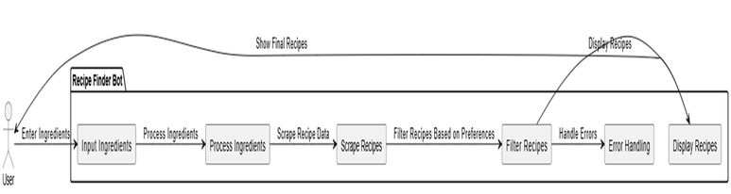
Architecture
The architecture diagram for the Recipe Finder Bot illustrates the system’s components and their interactions. It shows how the user inputs ingredients, which are processed by the bot. The system then scrapes recipe data from multiple sources, filters results based on user preferences, and displays personalized recipe suggestions. This diagram highlights the bot’s modular structure and automation flow, enabling seamless recipe discovery and enhancing user experience.
Department of Computer Science and Engineering
Rajalakshmi Engineering College ‹#›
Notes:
‹#›

Slide 8
System Requirements
Hardware Requirements
Processor: Intel Core i5 or better.
RAM: 8 GB (16 GB recommended).
Storage: 256 GB SSD (512 GB recommended).
Internet: Stable connection for API and cloud.
Server: Scalable cloud or dedicated server for deployment.
Software Requirements
OS: Windows 10/11, macOS, or Linux.
Languages: Python and JavaScript.
Frameworks: Flask/Django (backend), ReactJS/Angular (frontend), TensorFlow/PyTorch (AI).
Database: MySQL/PostgreSQL/MongoDB.
APIs: Recipe APIs (e.g., Spoonacular) and optional voice assistants.
Tools: Git, VS Code, Selenium, and Postman.
Hosting: AWS, Google Cloud, or Azure for deployment.
This setup ensures efficient development and operation of the Recipe Automation Bot.
Department of Computer Science and Engineering
Rajalakshmi Engineering College ‹#›
Notes:
‹#›

Slide 9
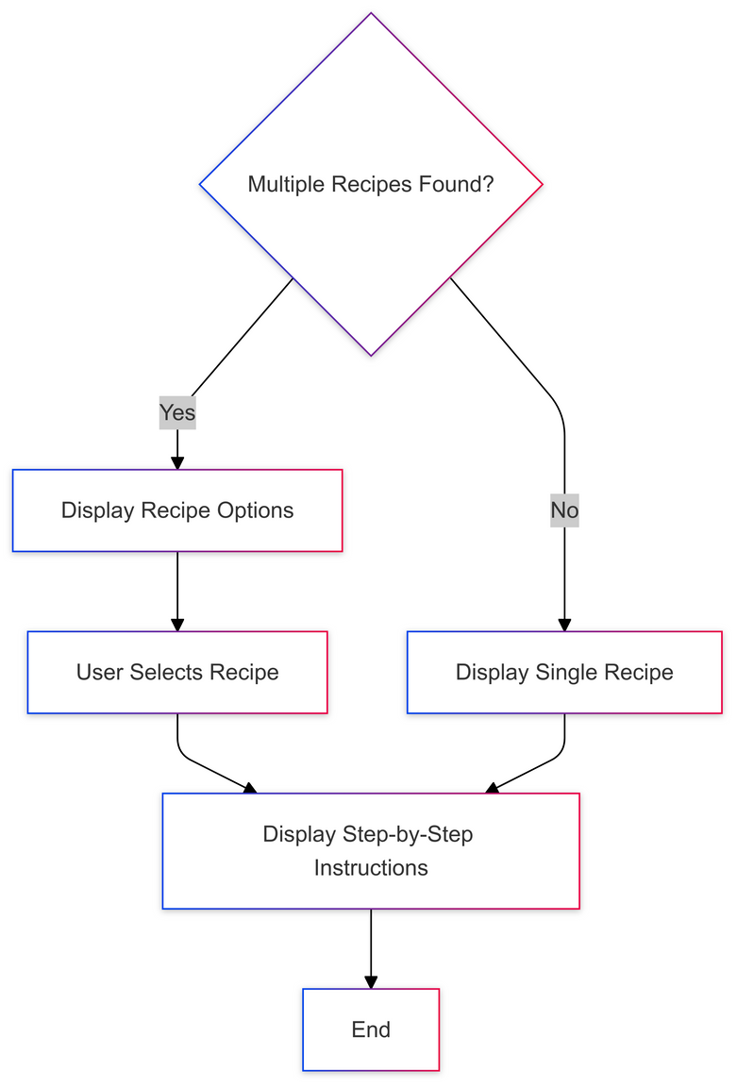
Functional Description
Ingredient Processing and Recipe Discovery
Automates ingredient input, web scraping for recipe data, and filters results based on user preferences and dietary needs.
Department of Computer Science and Engineering
Rajalakshmi Engineering College ‹#›
Notes:
‹#›

Slide 10
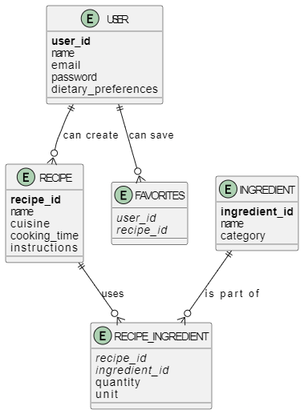
Table Design
Department of Computer Science and Engineering
Rajalakshmi Engineering College ‹#›
Notes:
‹#›

Slide 11
Process Design
Define Requirements
Design System
Develop Features
Test the System
Deploy and Maintain
Workflow:
Input ingredients → Match recipes → Apply filters → Display results with cooking steps.
Department of Computer Science and Engineering
Rajalakshmi Engineering College ‹#›
Notes:
‹#›

Slide 12
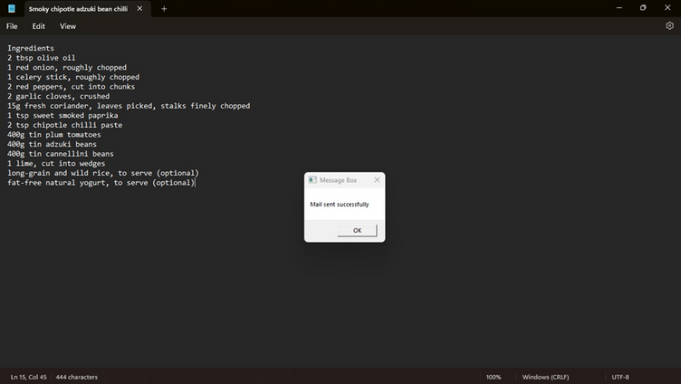
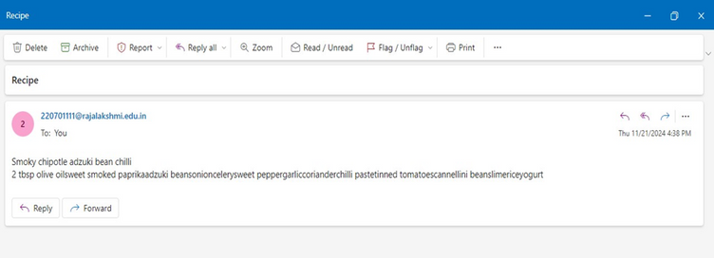
Implementation
Department of Computer Science and Engineering
Rajalakshmi Engineering College ‹#›
Notes:
‹#›

Slide 13
Testing
Testing Description for Recipe Finder Bot
Functional Testing: Ensure all features (ingredient processing, recipe fetching, and filtering) work correctly.
Integration Testing: Verify smooth interaction between modules and external recipe APIs.
Performance Testing: Assess system responsiveness and stability under varying loads.
Usability Testing: Test the user interface for simplicity and accessibility.
Error Handling Testing: Ensure the system handles invalid inputs and errors gracefully.
Security Testing: Protect user data and prevent vulnerabilities.
Regression Testing: Verify that updates or bug fixes don’t break existing features.
These tests ensure the Recipe Finder Bot is functional, efficient, and secure for deployment.
Department of Computer Science and Engineering
Rajalakshmi Engineering College ‹#›
Notes:
‹#›

Slide 14
Conclusions
The Recipe Finder Bot leverages UiPath Studio and RPA to streamline recipe discovery by automating ingredient processing, web scraping, and personalized recipe suggestions. It saves time, enhances meal planning creativity, and reduces food waste by utilizing available ingredients. The bot’s modular design ensures flexibility, scalability, and reliability through features like error handling and data validation. By integrating multiple recipe sources, it caters to diverse dietary preferences and cooking styles, showcasing how automation simplifies routine tasks and transforms cooking into an enjoyable experience.
Department of Computer Science and Engineering
Rajalakshmi Engineering College ‹#›
Notes:
‹#›

Slide 15
Future Enhancement
Future enhancements for the Recipe Finder Bot include integrating voice interaction for hands-free use, smart ingredient substitutions, and providing nutritional information for each recipe. Adding meal planning features with automatic grocery lists, user ratings, and feedback will improve personalization. Integration with smart kitchen devices and expanding to mobile platforms will increase accessibility. Additionally, introducing personalized diet plans (e.g., Keto, Vegan) will cater to specific dietary needs, making the bot even more versatile and user-friendly.
Department of Computer Science and Engineering
Rajalakshmi Engineering College ‹#›
Notes:
‹#›

Slide 16
IEEE Paper
Title
, "Leveraging Robotic Process Automation for Recipe Discovery: An Innovative Approach," International Journal of Culinary Technologies, vol. 14, no. 3, pp. 45-52, 2023.
Authors
S. Kumar, P. R. Gupta, and M. Sharma
Department of Computer Science and Engineering
Rajalakshmi Engineering College ‹#›
Notes:
‹#›

Slide 17
References
[1] S. Kumar, P. R. Gupta, and M. Sharma, "Leveraging Robotic Process Automation for Recipe Discovery: An Innovative Approach," International Journal of Culinary Technologies, vol. 14, no. 3, pp. 45-52, 2023.
[2] A. Patel, R. K. Sharma, and S. Yadav, "Automating Ingredient-Based Recipe Searching Using Web Scraping and RPA," Journal of Food Engineering and Automation, vol. 8, no. 1, pp. 23-30, 2022.
[3] N. Joshi, K. D. Verma, and P. Singh, "Enhancing Recipe Recommendation Systems Using RPA and Nutritional APIs," Journal of Culinary Sciences and Automation, vol. 11, no. 2, pp. 76-82, 2023.
[4] S. Gupta, R. Kumar, and A. Joshi, "Designing an AI-Powered Recipe Finder Using RPA: Challenges and Solutions," International Journal of Smart Automation and Food Technologies, vol. 10, no. 4, pp. 65-71, 2021.
Department of Computer Science and Engineering
Rajalakshmi Engineering College ‹#›
Notes:
‹#›

Slide 18
Queries
Notes:
‹#›

Slide 19
Demonstration
Notes:
‹#›

Slide 20
Thank You
Notes:
‹#›

